Slide 1
MIPS Pipeline
Hazards
Notes:
Morgan Kaufmann Publishers
Chapter 4 — The Processor

Slide 2
Hazards
There are situations in pipelining when the next instruction cannot execute in the following clock cycle.
Three different types
  Structural hazards: HW cannot support this combination of instructions
  Data hazards: Instruction depends on result of prior instruction still in the pipeline
  Control hazards: Pipelining of branches & other instructions that change the PC
  Common solution is to stall the pipeline until the hazard is resolved, inserting one or more “bubbles” in the pipeline
Notes:
Morgan Kaufmann Publishers
Chapter 4 — The Processor

Slide 3
Hazards
Structure hazards
  A required resource is busy
  MIPS instruction and data memory helps pipelining
  When I1 reads memory, I4 reads instruction
  Separate Instruction and data memory will help I1 and I4 to continue in parallel
I1 | IF | ID | EX | MEM | WB
I2 |  | IF | ID | EX | MEM | WB
I3 |  |  | IF | ID | EX | MEM | WB
I4 |  |  |  | IF | ID | EX | MEM | WB
Notes:
Morgan Kaufmann Publishers
Chapter 4 — The Processor

Slide 4
Data Hazard

Slide 5
Data hazard
One instruction waiting for the result of previous instruction
Solution
  Stall
    Need to wait for previous instruction to complete its data read/write
  Forward
Instruction type : Hazard solutions
  R-type - arithemetic : Forwarding Unit
  Lw – data transfer : Hazard Detection Unit
Notes:
Morgan Kaufmann Publishers
Chapter 4 — The Processor

Slide 6
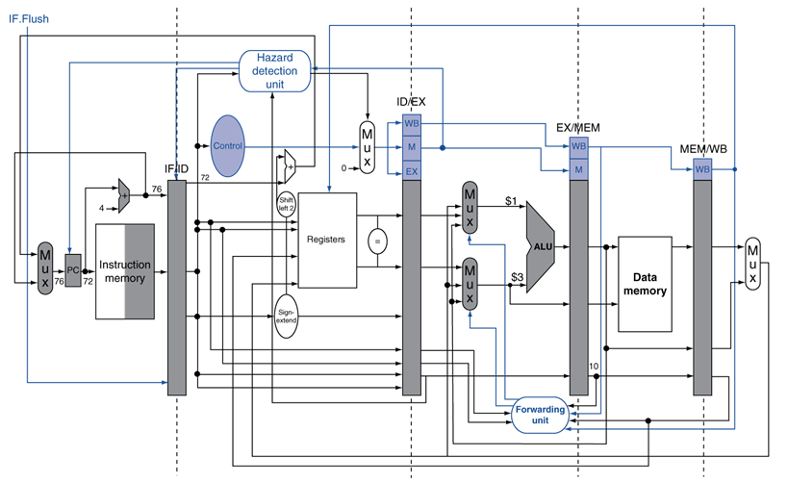
Data Hazard
Notes:
Morgan Kaufmann Publishers
Chapter 4 — The Processor

Slide 7
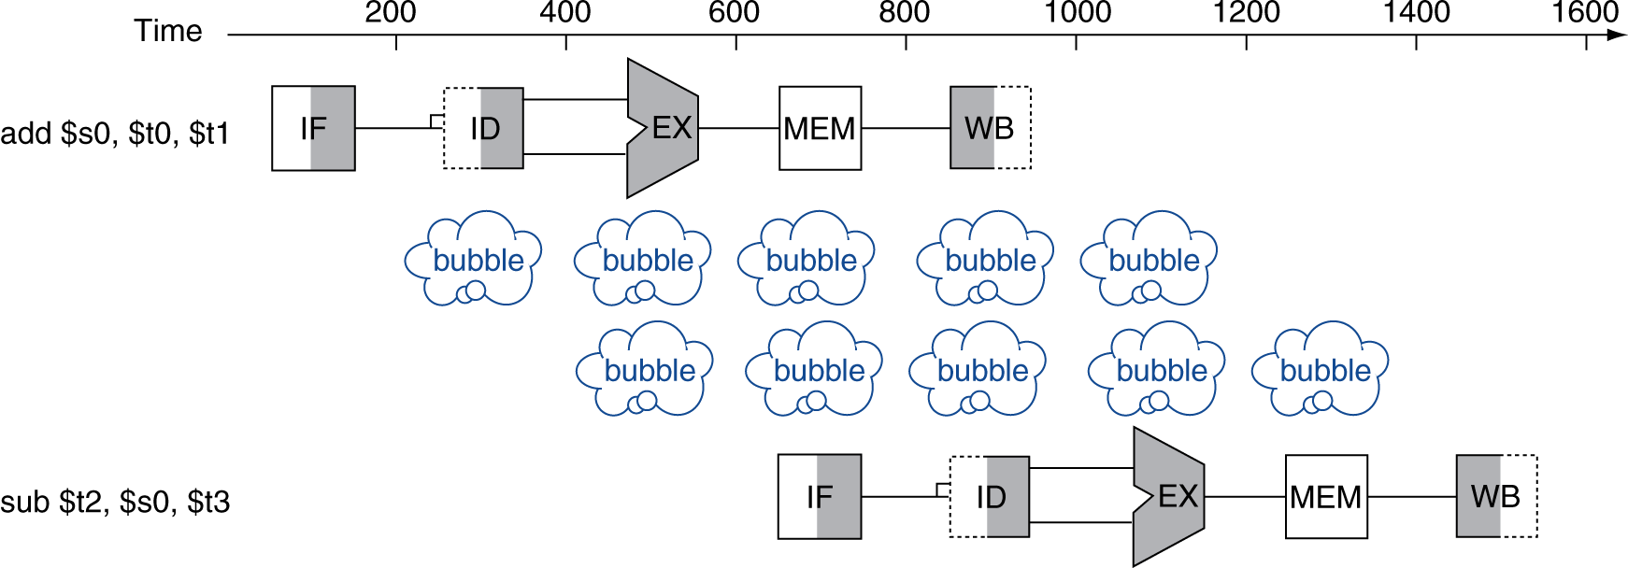
Stall
  Need to wait for previous instruction to complete its data read/write
  Source reg of 2nd instruction is destination reg of 1st instruction
add $s0, $t0, $t1
sub $t2, $s0, $t3
add | IF | ID | EX | MEM | WB
Sub |  | IF | ID | ID | ID | EX | MEM | WB
 |  |  | IF | IF | IF | ID | EX | MEM
 |  |  |  |  |  | IF | ID | EX
Notes:
Morgan Kaufmann Publishers
Chapter 4 — The Processor

Slide 8
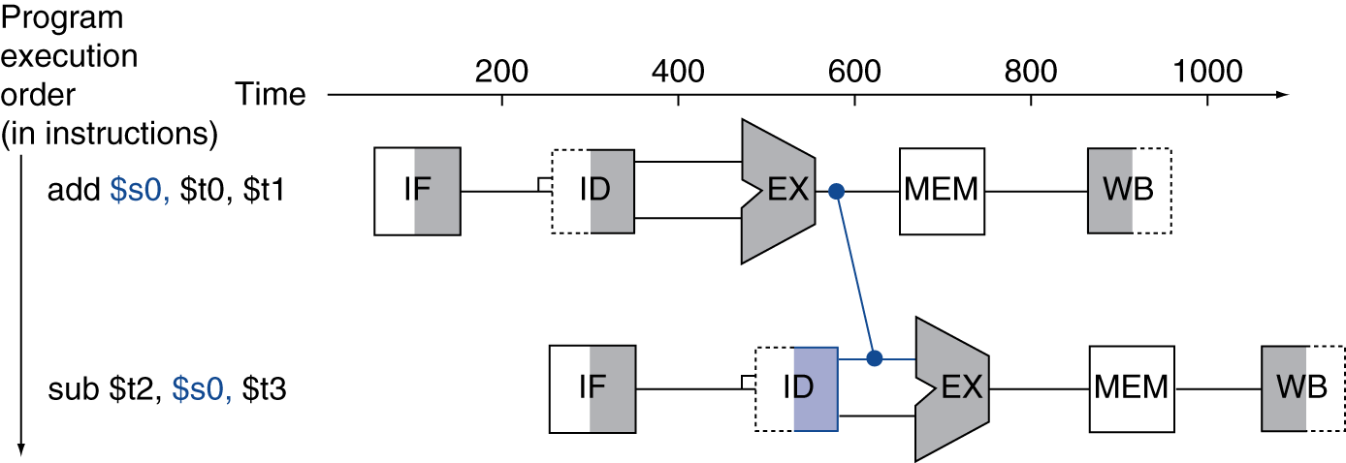
Forwarding
Adding extra hardware to retrieve the missing item early from the internal resources is called forwarding or bypassing
As soon as the ALU creates the sum for the add, we can supply it as an input for the subtract
Use result when it is computed
  Don’t wait for it to be stored in a register
  Requires extra connections in the datapath
Notes:
Morgan Kaufmann Publishers
Chapter 4 — The Processor

Slide 9
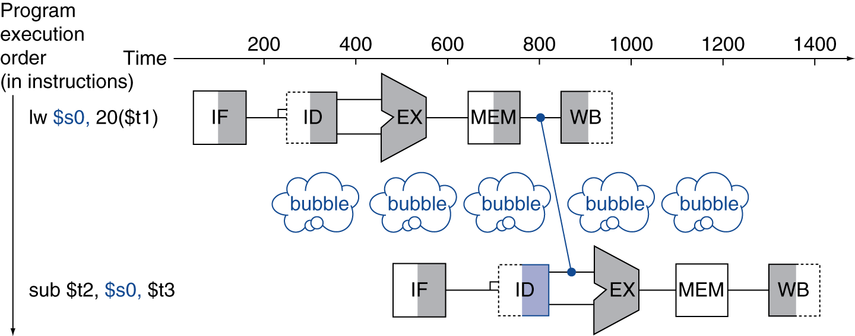
Load-Use Data Hazard
Can’t always avoid stalls by forwarding
  If value not computed when needed
  Can’t forward backward in time
Data from lw instruction is available only after MEM
So there is a stall
Notes:
Morgan Kaufmann Publishers
Chapter 4 — The Processor

Slide 10
I: Data Hazards in ALU Instructions
Consider this sequence:
  sub $2, $1,$3
  and $12,$2,$5
  or $13,$6,$2
  add $14,$2,$2
  sw $15,100($2)
We can resolve hazards with forwarding
  How do we detect when to forward?
§4.7 Data Hazards: Forwarding vs. Stalling
Notes:
Morgan Kaufmann Publishers
Chapter 4 — The Processor

Slide 11
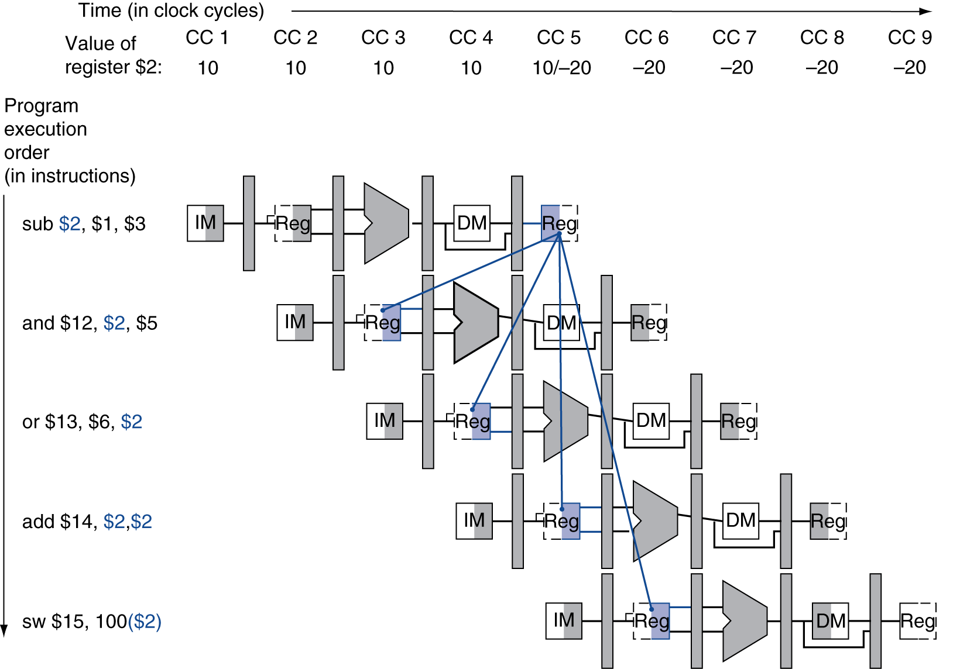
Dependencies
Notes:
Morgan Kaufmann Publishers
Chapter 4 — The Processor

Slide 12
Dependencies & Need for Forwarding
Notes:
Morgan Kaufmann Publishers
Chapter 4 — The Processor

Slide 13
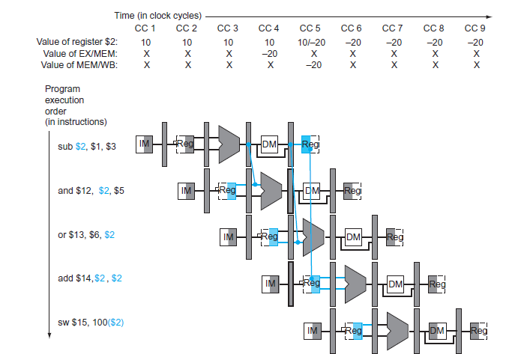
Dependencies & Forwarding
Notes:
Morgan Kaufmann Publishers
Chapter 4 — The Processor

Slide 14
Forwarding Conditions
EX hazard
  if (EX/MEM.RegWrite and (EX/MEM.RegisterRd ≠ 0)
  and (EX/MEM.RegisterRd = ID/EX.RegisterRs))
  ForwardA = 10
  if (EX/MEM.RegWrite and (EX/MEM.RegisterRd ≠ 0)
  and (EX/MEM.RegisterRd = ID/EX.RegisterRt))
  ForwardB = 10
MEM hazard
  if (MEM/WB.RegWrite and (MEM/WB.RegisterRd ≠ 0)
  and (MEM/WB.RegisterRd = ID/EX.RegisterRs))
  ForwardA = 01
  if (MEM/WB.RegWrite and (MEM/WB.RegisterRd ≠ 0)
  and (MEM/WB.RegisterRd = ID/EX.RegisterRt))
  ForwardB = 01
Notes:
Morgan Kaufmann Publishers
Chapter 4 — The Processor

Slide 15
Forwarding Conditions 1
Data hazards when
  1a. If(EX/MEM.RegisterRd = ID/EX.RegisterRs)
  1b.if( EX/MEM.RegisterRd = ID/EX.RegisterRt)
  2a. If(MEM/WB.RegisterRd = ID/EX.RegisterRs)
  2b. If(MEM/WB.RegisterRd = ID/EX.RegisterRt)
Fwd from
EX/MEM
pipeline reg
Fwd from
MEM/WB
pipeline reg
sub | IF | ID | EX | MEM | WB
and |  | IF | ID | EX | MEM | WB
 |  |  | IF | ID | EX | MEM | WB
 |  |  |  | IF | ID | EX | MEM | WB
Notes:
Morgan Kaufmann Publishers
Chapter 4 — The Processor

Slide 16
Forwarding Conditions 1
Data hazards when
  1a. If(EX/MEM.RegisterRd = ID/EX.RegisterRs)
  1b.if( EX/MEM.RegisterRd = ID/EX.RegisterRt)
  2a. If(MEM/WB.RegisterRd = ID/EX.RegisterRs)
  2b. If(MEM/WB.RegisterRd = ID/EX.RegisterRt)
Example
2a hazard $2
sub $2, $1,$3 MEM/WB.RegisterRd
and $12, $2, $5
or $13, $2, $6 ID/EX.RegisterRs
Example
1a hazard $2
sub $2, $1,$3 EX/MEM.RegisterRd
and $12,$2,$5 ID/EX.RegisterRs
Example
1b hazard $2
sub $2, $1,$3 EX/MEM.RegisterRd
and $12,$5,$2 ID/EX.RegisterRt
Example
2b hazard $2
sub $2, $1,$3 MEM/WB.RegisterRd
and $12, $2, $5
or $13, $6, $2 ID/EX.RegisterRt
Notes:
Morgan Kaufmann Publishers
Chapter 4 — The Processor

Slide 17
Forwarding Conditions 2
Some instructions do not write registers (sw,beq)
Need to forward only when the previous instrution write the register (RegWrite )
Forward only when RegWrite control signal is active (R type, lw)
    If (EX/MEM.RegWrite)
    If( MEM/WB.RegWrite)
Notes:
Morgan Kaufmann Publishers
Chapter 4 — The Processor

Slide 18
Forwarding Conditions 3
And only if Rd for that instruction is not $zero
  If Rd is zero need not write as this register will always have 0
    If(EX/MEM.RegisterRd ≠ 0)
    If(MEM/WB.RegisterRd ≠ 0)
Notes:
Morgan Kaufmann Publishers
Chapter 4 — The Processor

Slide 19
Forwarding Conditions
EX hazard
  if (EX/MEM.RegWrite and (EX/MEM.RegisterRd ≠ 0)
  and (EX/MEM.RegisterRd = ID/EX.RegisterRs))
  ForwardA = 10
  if (EX/MEM.RegWrite and (EX/MEM.RegisterRd ≠ 0)
  and (EX/MEM.RegisterRd = ID/EX.RegisterRt))
  ForwardB = 10
MEM hazard
  if (MEM/WB.RegWrite and (MEM/WB.RegisterRd ≠ 0)
  and (MEM/WB.RegisterRd = ID/EX.RegisterRs))
  ForwardA = 01
  if (MEM/WB.RegWrite and (MEM/WB.RegisterRd ≠ 0)
  and (MEM/WB.RegisterRd = ID/EX.RegisterRt))
  ForwardB = 01
Notes:
Morgan Kaufmann Publishers
Chapter 4 — The Processor

Slide 20
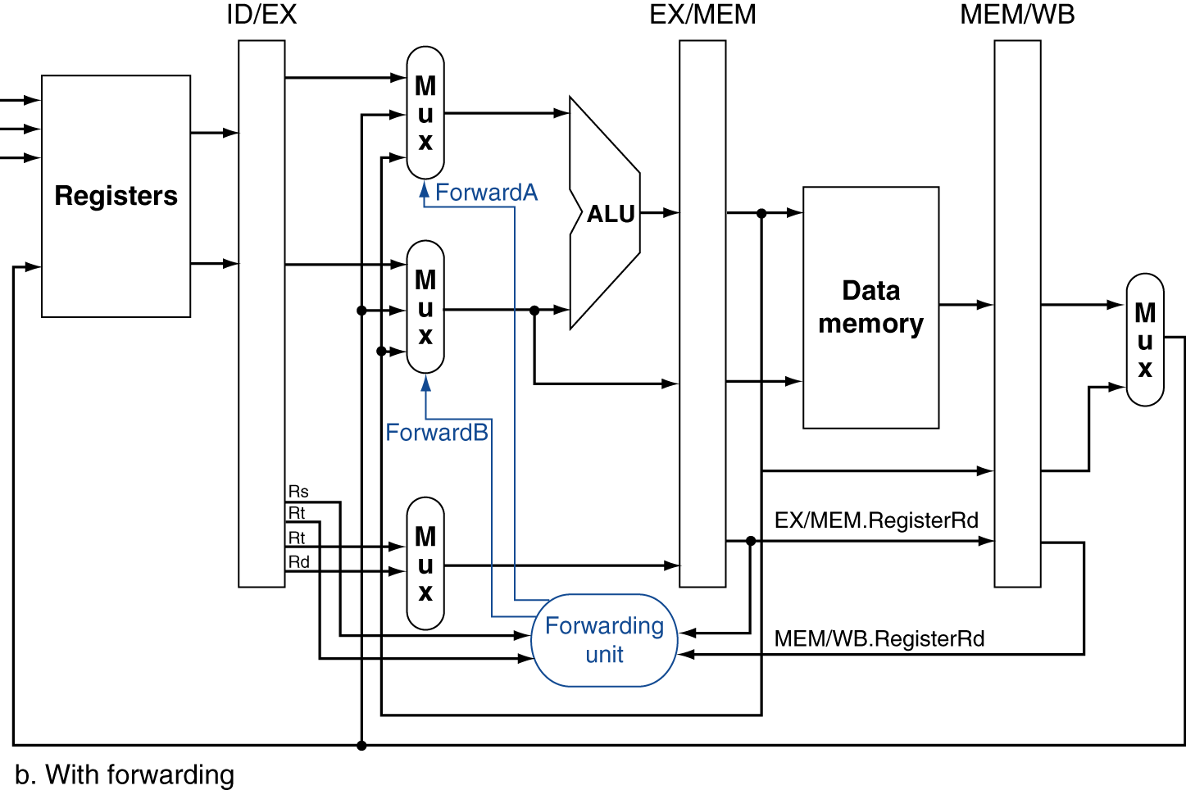
Forwarding Paths
Notes:
Morgan Kaufmann Publishers
Chapter 4 — The Processor

Slide 21
Double Data Hazard
Consider the sequence:
  add $1,$1,$2
  add $1,$1,$3
  add $1,$1,$4
Both hazards occur
  Want to use the most recent
Revise MEM hazard condition
  Only fwd if EX hazard condition isn’t true
Notes:
Morgan Kaufmann Publishers
Chapter 4 — The Processor

Slide 22
Revised Forwarding Condition
MEM hazard
  if (MEM/WB.RegWrite and (MEM/WB.RegisterRd ≠ 0)
  and not (EX/MEM.RegWrite and (EX/MEM.RegisterRd ≠ 0)
  and (EX/MEM.RegisterRd = ID/EX.RegisterRs))
  and (MEM/WB.RegisterRd = ID/EX.RegisterRs))
  ForwardA = 01
  if (MEM/WB.RegWrite and (MEM/WB.RegisterRd ≠ 0)
  and not (EX/MEM.RegWrite and (EX/MEM.RegisterRd ≠ 0)
  and (EX/MEM.RegisterRd = ID/EX.RegisterRt))
  and (MEM/WB.RegisterRd = ID/EX.RegisterRt))
  ForwardB = 01
Notes:
Morgan Kaufmann Publishers
Chapter 4 — The Processor

Slide 23
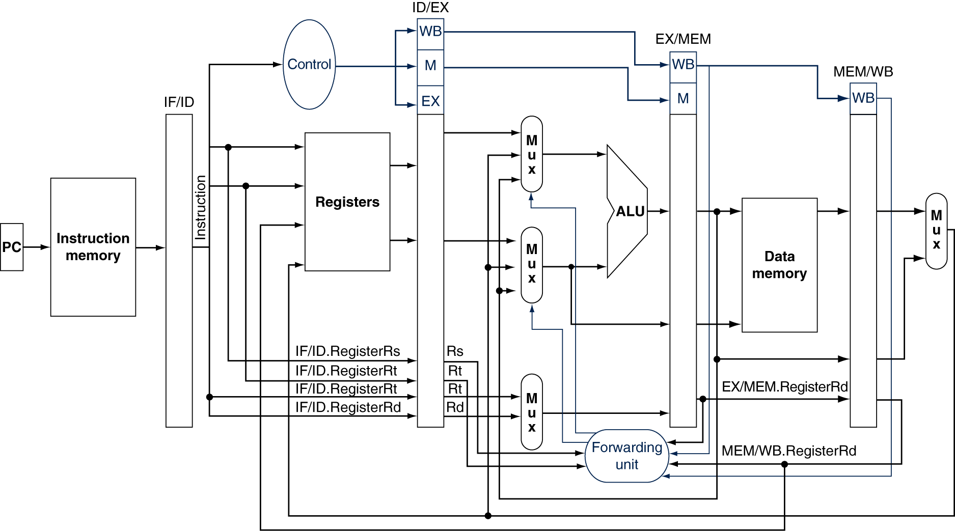
Datapath with Forwarding
multiplexors to the inputs to the ALU consider data forwarding
Notes:
Morgan Kaufmann Publishers
Chapter 4 — The Processor

Slide 24
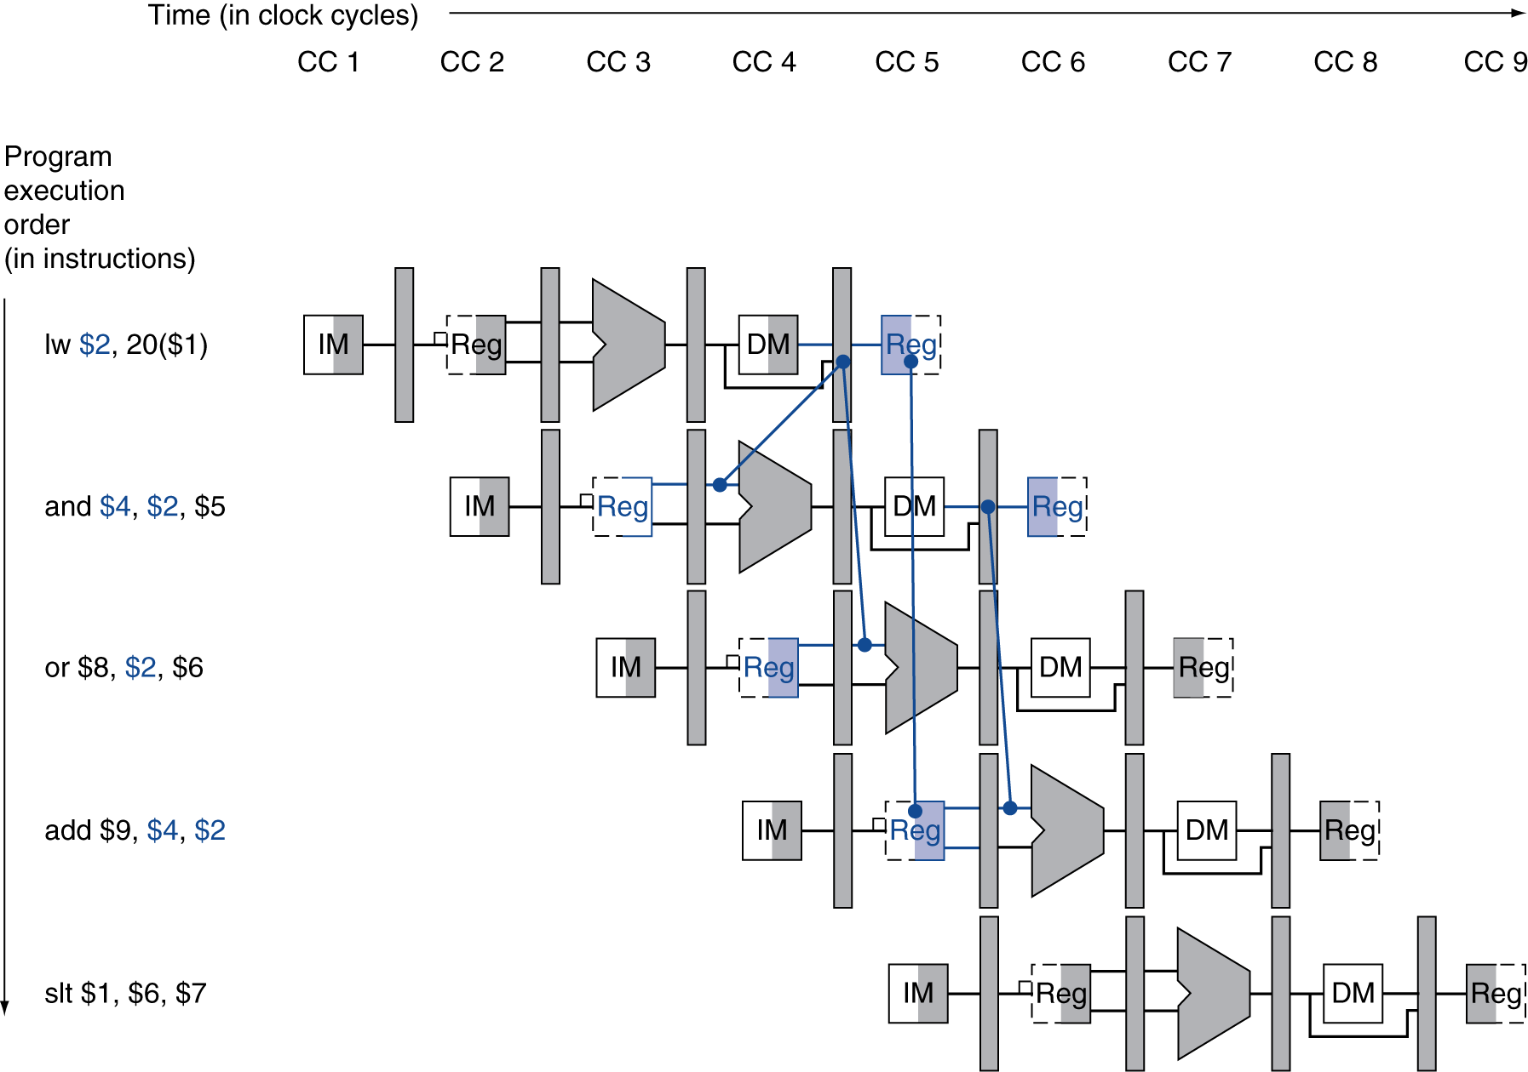
II: Data Hazard
Load-Use Data Hazard
Need to stall for one cycle
Eg:
    lw $2, 20($1) # lw instruction’s reg rt is next and instructions’s rs
    and $4, $2, $5
Notes:
Morgan Kaufmann Publishers
Chapter 4 — The Processor

Slide 25
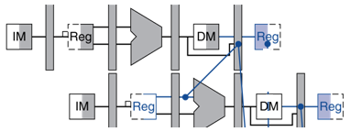
Load-Use Hazard Detection
Eg:
    lw $2, 20($1
    and $4, $2, $5
Use “hazard detection unit”
It operates during the ID stage
It insert stall
1: ID/EX.MemRead : checks if instruction is a load instruction
2: ID/EX.RegisterRt : Lw instructions destination reg
  IF/ID.RegisterRs, IF/ID.RegisterRt : ALU instructions operand
Load-use hazard when
  ID/EX.MemRead and
  ((ID/EX.RegisterRt = IF/ID.RegisterRs) or
  (ID/EX.RegisterRt = IF/ID.RegisterRt))
stall
Notes:
Morgan Kaufmann Publishers
Chapter 4 — The Processor

Slide 26
How to Stall the Pipeline
Stall : using a nop (no-operation) instruction
1. Force control values in ID/EX register to 0
  EX, MEM and WB do nop (no-operation)
2. Prevent update of PC and IF/ID register
  current instruction is decoded again
  Following instruction is fetched again
  1-cycle stall allows MEM to read data for lw
Notes:
Morgan Kaufmann Publishers
Chapter 4 — The Processor

Slide 27
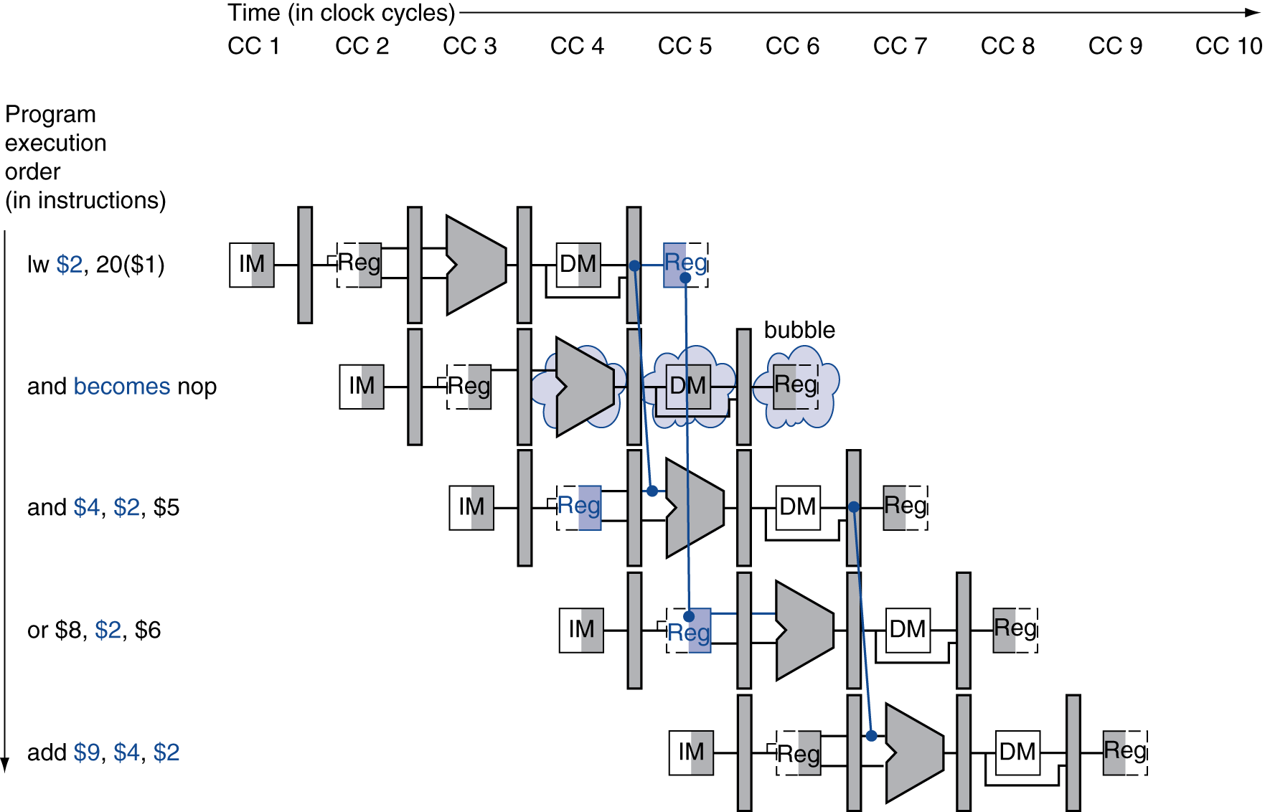
Stall/Bubble in the Pipeline
ID/EX register to 0
Prevent update of PC and IF/ID register
Stall inserted here
Notes:
Morgan Kaufmann Publishers
Chapter 4 — The Processor

Slide 28
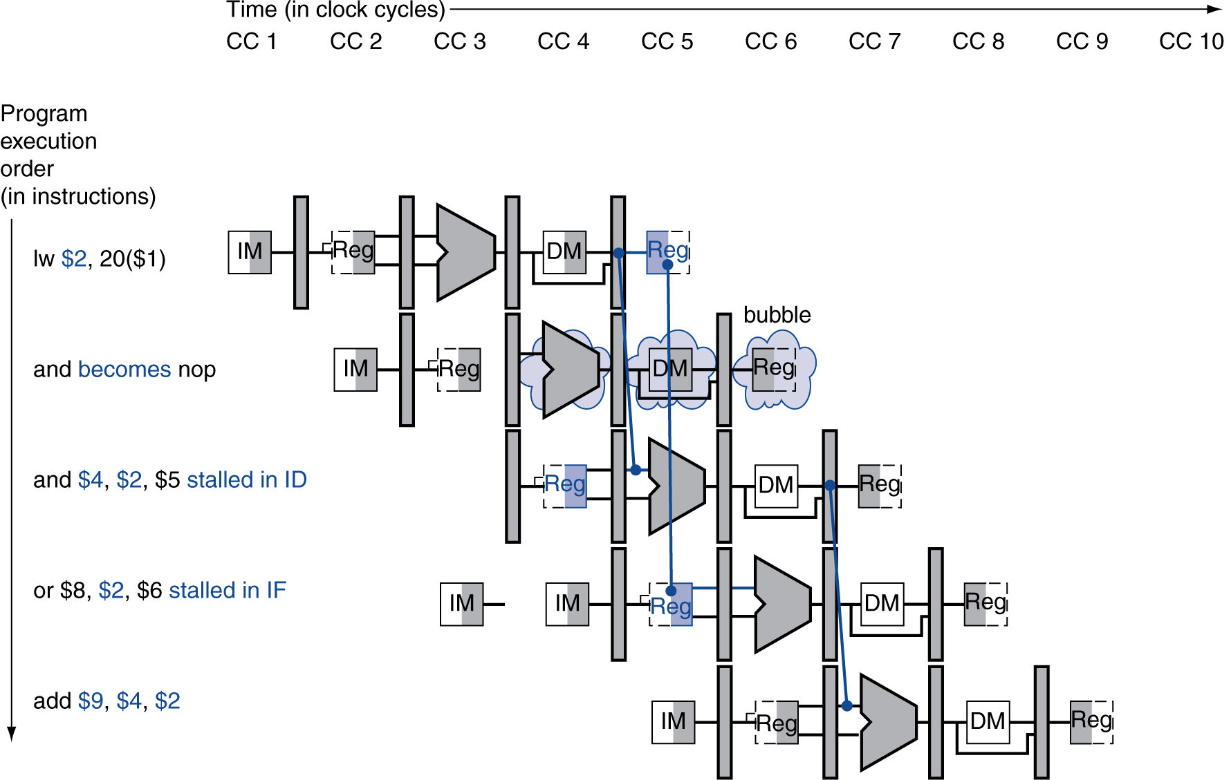
Stall/Bubble in the Pipeline
  current instruction is decoded again
  Following instruction is fetched again
Notes:
Morgan Kaufmann Publishers
Chapter 4 — The Processor

Slide 29
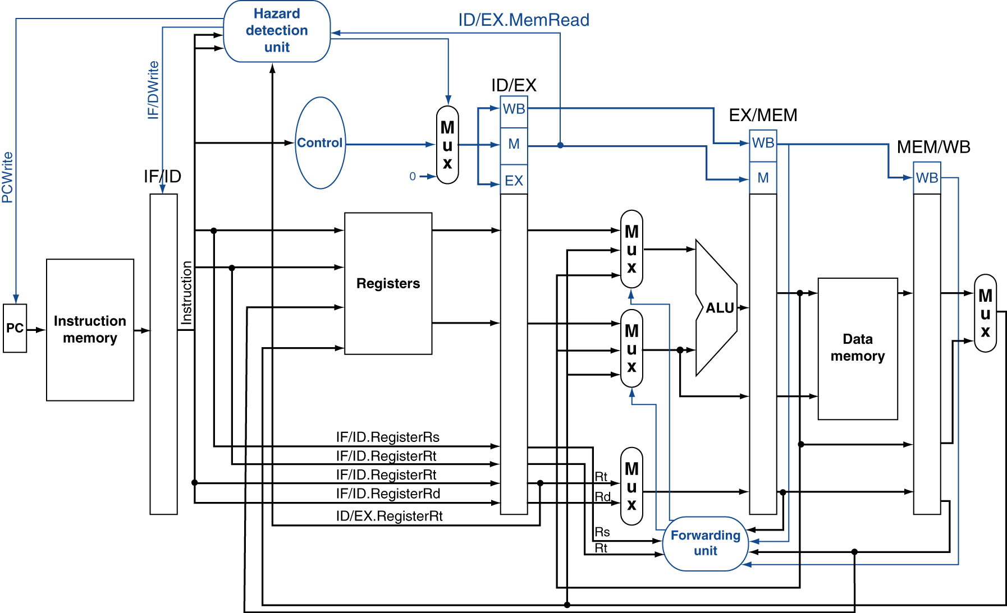
Datapath with Hazard Detection
Notes:
Morgan Kaufmann Publishers
Chapter 4 — The Processor

Slide 30
Control Hazard

Slide 31
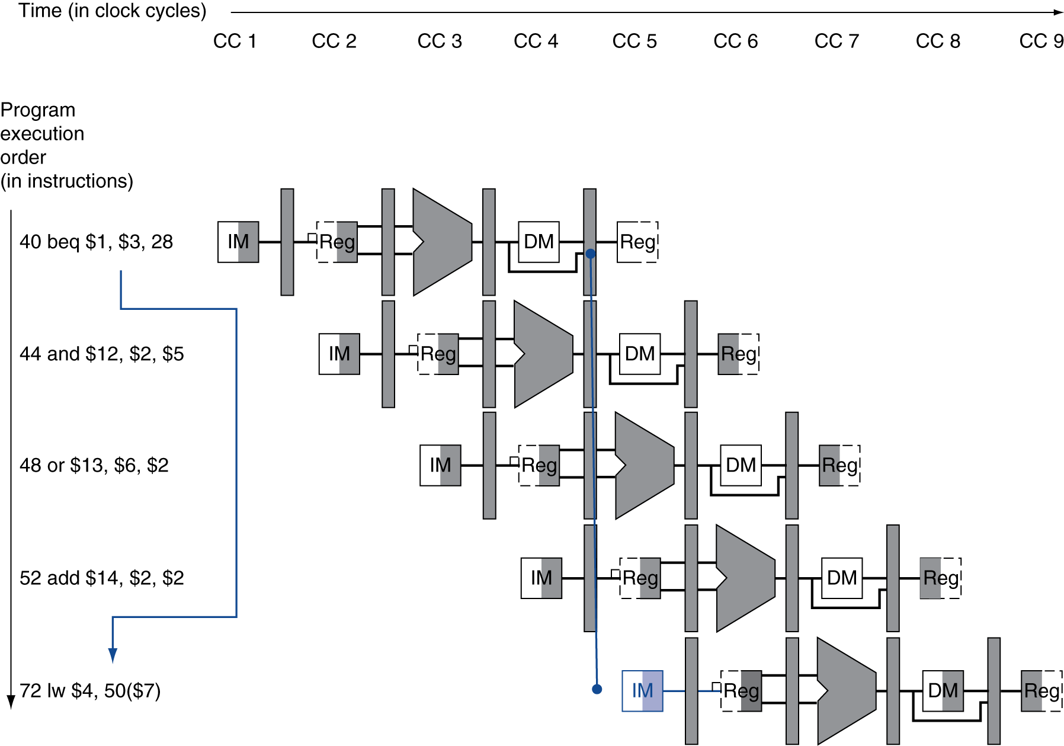
Control/Branch Hazards
Example: branch taken
  36: sub $10, $4, $8
  40: beq $1, $3, 7
  44: and $12, $2, $5
  48: or $13, $2, $6
  52: add $14, $4, $2
  56: slt $15, $6, $7
  ...
  72: lw $4, 50($7)
If branch outcome determined in MEM
Flush these
instructions
(Set control
values to 0)
PC
Notes:
Morgan Kaufmann Publishers
Chapter 4 — The Processor

Slide 32
Control Hazard
Need to make a branch decision based on the results of one instruction while others are execution
  Stall
  Predict

Slide 33
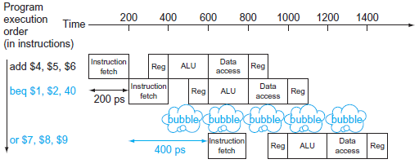
Control Hazard
Stall
  Wait until the pipeline determines the outcome of the branch and knows what instruction address to fetch from
  Put in enough extra hardware so that we can test registers, calculate the branch address, and update the PC during the second stage (ID) of the pipeline

Slide 34
Reducing Branch Delay
Next PC for a branch is selected in the MEM stage
If we move the branch execution earlier in the pipeline, then only fewer instructions need be flushed
Needs more hardware to determine outcome to ID stage
  Target address adder
  Register comparator
Notes:
Morgan Kaufmann Publishers
Chapter 4 — The Processor

Slide 35
Reducing Branch Delay
Needs more hardware to determine outcome to ID stage
  Target address adder
    Calculation is easy with PC and immediate value so this can be moved from EX stage to ID stage
  Register comparator
    Branch decision is the harder part
    Simple branch test can be done with few gates without ALU
    Eg: Equality test
OP1 | 0110
OP2 | 0111
Xor | 0001
Or all bits | 1 (not equal)
OP1 | 0110
OP2 | 0110
Xor | 0000
Or all bits | 0 (equal)
Notes:
Morgan Kaufmann Publishers
Chapter 4 — The Processor

Slide 36
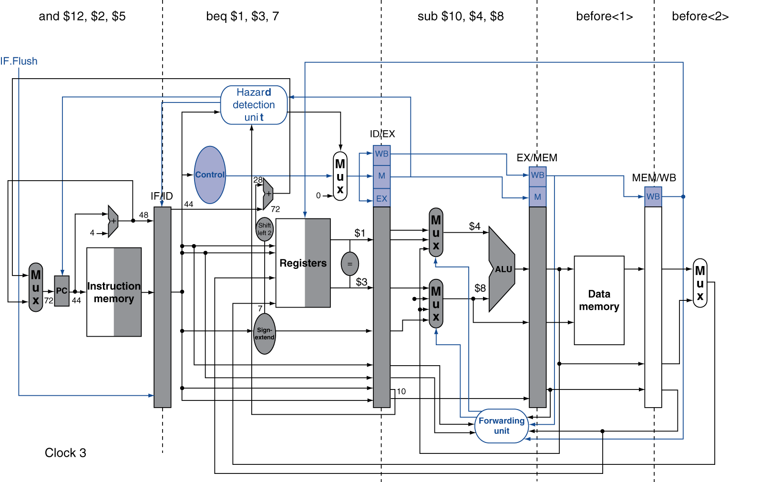
Example: Branch Taken
Notes:
Morgan Kaufmann Publishers
Chapter 4 — The Processor

Slide 37
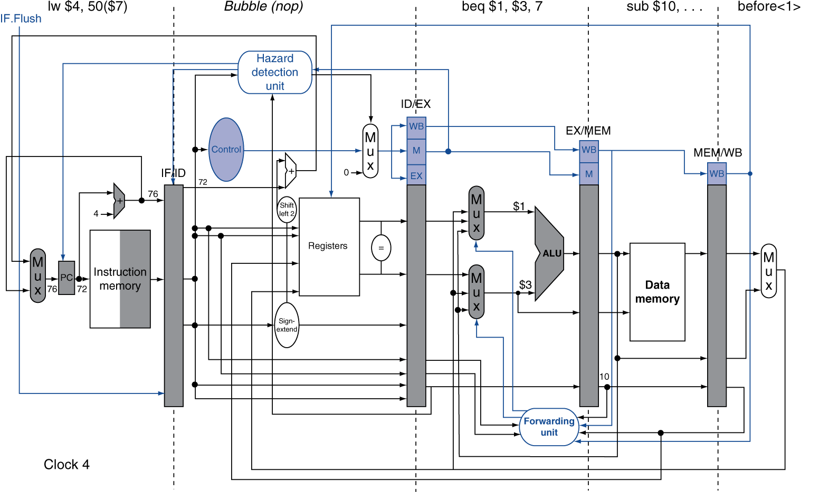
Example: Branch Taken
Notes:
Morgan Kaufmann Publishers
Chapter 4 — The Processor

Slide 38
Data Hazards for Branches
If a comparison register is a destination of 2nd or 3rd preceding ALU instruction
add $1, $2, $3
IF
ID
EX
MEM
WB
add $4, $5, $6
IF
ID
EX
MEM
WB
…
IF
ID
EX
MEM
WB
beq $1, $4, target
IF
ID
EX
MEM
WB
Can resolve using forwarding
Notes:
Morgan Kaufmann Publishers
Chapter 4 — The Processor

Slide 39
Data Hazards for Branches
If a comparison register is a destination of preceding ALU instruction or 2nd preceding load instruction
  Need 1 stall cycle
lw $1, addr
IF
ID
EX
MEM
WB
add $4, $5, $6
IF
ID
EX
MEM
WB
beq stalled
IF
ID
beq $1, $4, target
ID
EX
MEM
WB
Notes:
Morgan Kaufmann Publishers
Chapter 4 — The Processor

Slide 40
Data Hazards for Branches
If a comparison register is a destination of immediately preceding load instruction
  Need 2 stall cycles
lw $1, addr
IF
ID
EX
MEM
WB
beq stalled
IF
ID
beq stalled
ID
beq $1, $0, target
ID
EX
MEM
WB
Notes:
Morgan Kaufmann Publishers
Chapter 4 — The Processor

Slide 41
Control Hazard
Static Prediction
  Assume branch will take
  Assume branch will not take
    When prediction is right, the pipeline proceeds at full speed
    If the prediction is wrong, the instructions that are being fetched and decoded must be discarded
    To discard instructions change the original control values to 0s
    Discard instruction in IF, ID, and EX stages
Dynamic Prediction
  Branch prediction made based on history

Slide 42
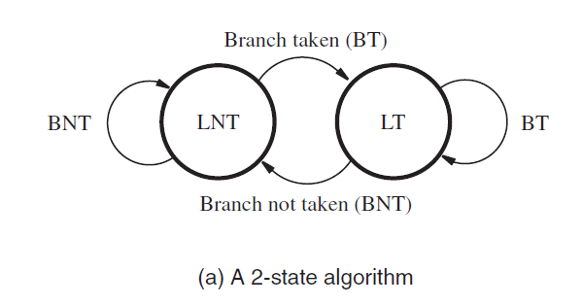
1-Bit Dynamic Predictor
Notes:
Morgan Kaufmann Publishers
Chapter 4 — The Processor

Slide 43
1-Bit Predictor: Shortcoming
Inner loop branches mispredicted twice!
outer: …
…
inner: …
…
beq …, …, inner
…
beq …, …, outer
  Mispredict as taken on last iteration of inner loop
  Then mispredict as not taken on first iteration of inner loop next time around
Notes:
Morgan Kaufmann Publishers
Chapter 4 — The Processor

Slide 44
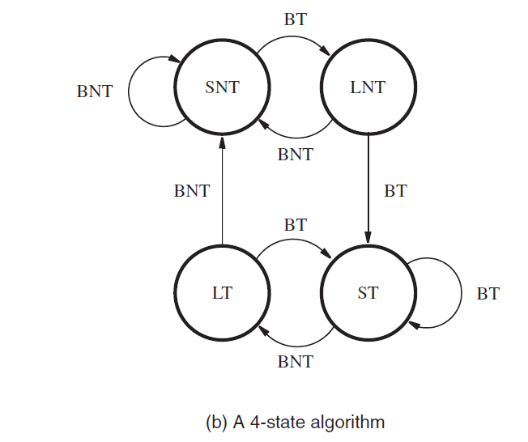
2-Bit Dynamic Predictor
Only change prediction on two successive mispredictions
ST - Strongly likely to be taken
LT - Likely to be taken
LNT - Likely not to be taken
SNT - Strongly likely not to be taken
Notes:
Morgan Kaufmann Publishers
Chapter 4 — The Processor

Slide 45
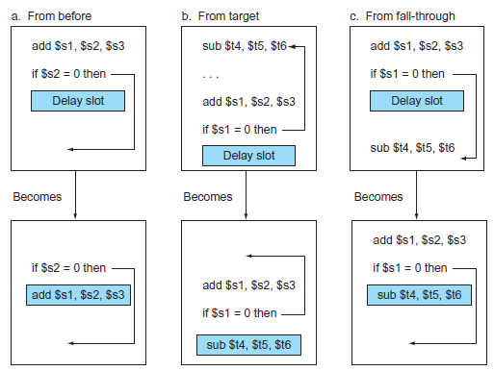
Scheduling the branch delay slot.

Slide 46
Exception

Slide 47
Exceptions and Interrupts
Flow of instructions are changed by
  branch or jump instruction
  “Unexpected” events requiring change in flow of control
Exception is another form of control hazard
Exception
  Arises within the CPU (Internal)
Interrupt
  From an external I/O controller (External)
Dealing with them without sacrificing performance is hard
Notes:
Morgan Kaufmann Publishers
Chapter 4 — The Processor

Slide 48
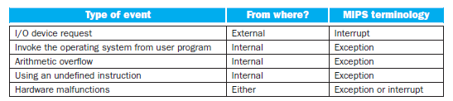
Exceptions and Interrupts
Notes:
Morgan Kaufmann Publishers
Chapter 4 — The Processor

Slide 49
Handling Exceptions
The basic action that the processor must perform when an exception occurs is
  Save the address of the offending instruction in the exception program counter (EPC)
  Transfer control to the operating system at some specified address
  Operating system then take the appropriate action,
      providing some service to the user program
      taking some predefined action in response to an overflow
      stopping the execution of the program
      reporting an error
  Then operating system can terminate the program or may continue its execution, using the EPC to determine where to restart the execution of the program
Notes:
Morgan Kaufmann Publishers
Chapter 4 — The Processor

Slide 50
Handling Exceptions
OS must know the
  Reason for the exception
  Instruction that caused it
There are two main methods used to communicate the reason for an exception
  status register (called the Cause register)
  vectored interrupts
Notes:
Morgan Kaufmann Publishers
Chapter 4 — The Processor

Slide 51

Handling Exceptions
Cause register
  used in the MIPS architecture
  holds a field that indicates the reason for the exception
  Use single entry point for all exceptions
  the operating system decodes the status register to find the cause
vectored interrupts
  address to which control is transferred is determined by the cause of the exception
Notes:
Morgan Kaufmann Publishers
Chapter 4 — The Processor

Slide 52
Handling Exceptions in MIPS
Cause register is used inMIPS
Single entry point being the address 8000 0180hex.
Handled by adding a few extra registers and control signals
Add two additional registers to our current MIPS implementation
  EPC: A 32-bit register used to hold the address of the affected instruction
  Cause: A register used to record the cause of the exception.
    32 bits register
    10 representing an undefined instruction
    12 representing arithmetic overflow
Notes:
Morgan Kaufmann Publishers
Chapter 4 — The Processor

Slide 53
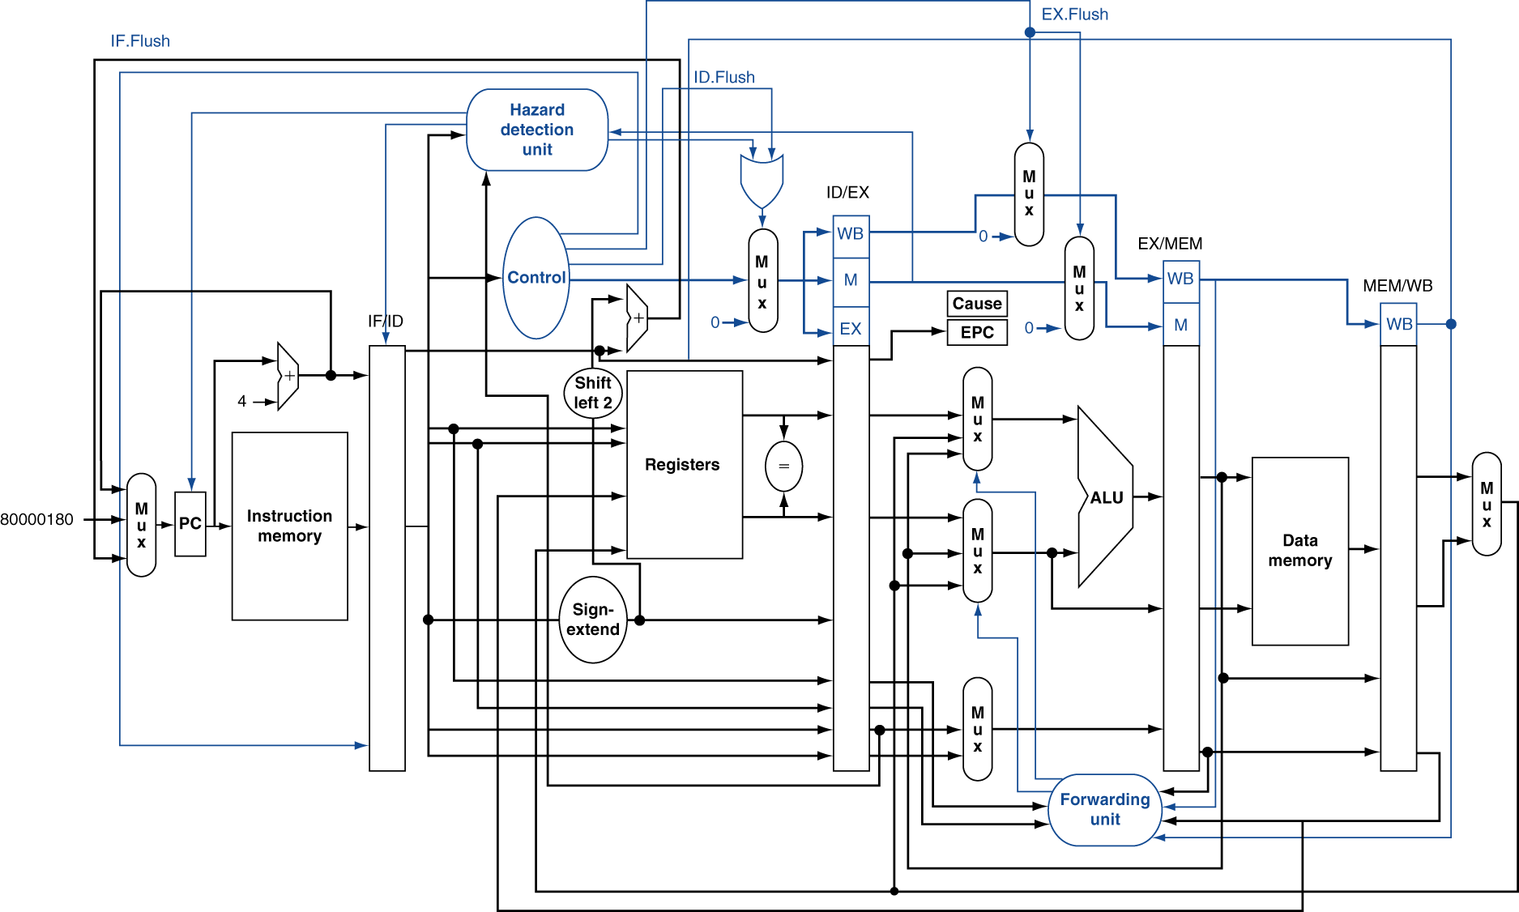
Pipeline with Exceptions
Notes:
Morgan Kaufmann Publishers
Chapter 4 — The Processor

Slide 54
Exceptions in a Pipeline
Consider overflow on add in EX stage
  add $1, $2, $1
  Complete previous instructions
  Flush add and subsequent instructions
  Set Cause and EPC register values
  Transfer control to handler
Similar to mispredicted branch
Notes:
Morgan Kaufmann Publishers
Chapter 4 — The Processor

Slide 55
Exceptions in a Pipeline
  Control Signals
  Flush will set all control signa;s to 0 so that the instruction becomes nop
  Similar to mispredicted branch
    branch uses IF.Flush
  Two new control signals are used to handle Exceptions
    ID.Flush
    EX.Flush
      Arithmetic exceptions are found in ALU EX stage
      So the instructions that precede this exception causing instruction can proceed but not the instruction that succeeds
      The succeeding instruction will be to its EX and ID stage so use flush
Notes:
Morgan Kaufmann Publishers
Chapter 4 — The Processor

Slide 56
Pipeline with Exceptions
Notes:
Morgan Kaufmann Publishers
Chapter 4 — The Processor

Slide 57
Exception Properties
Restartable exceptions
  Pipeline can flush the instruction
  Handler executes, then returns to the instruction
    Refetched and executed from scratch
PC saved in EPC register
  Identifies causing instruction
  Actually PC + 4 is saved
    Handler must adjust
Notes:
Morgan Kaufmann Publishers
Chapter 4 — The Processor

Slide 58
Exception Example
Exception on add in
  40 sub $11, $2, $4
  44 and $12, $2, $5
  48 or $13, $2, $6
  4C add $1, $2, $1
  50 slt $15, $6, $7
  54 lw $16, 50($7)
  …
Handler
  80000180 sw $25, 1000($0)
  80000184 sw $26, 1004($0)
  …
Notes:
Morgan Kaufmann Publishers
Chapter 4 — The Processor

Slide 59
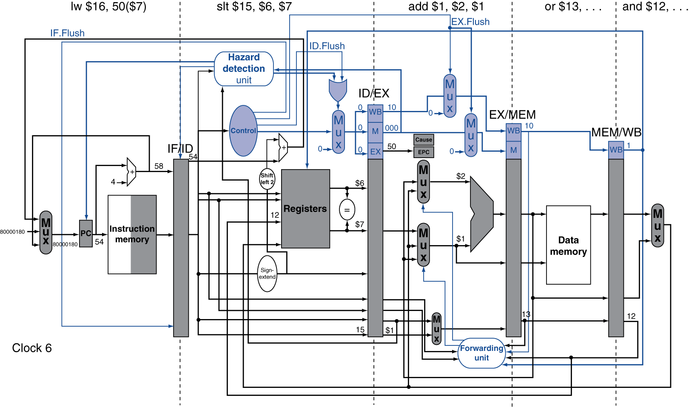
Exception Example
Notes:
Morgan Kaufmann Publishers
Chapter 4 — The Processor

Slide 60
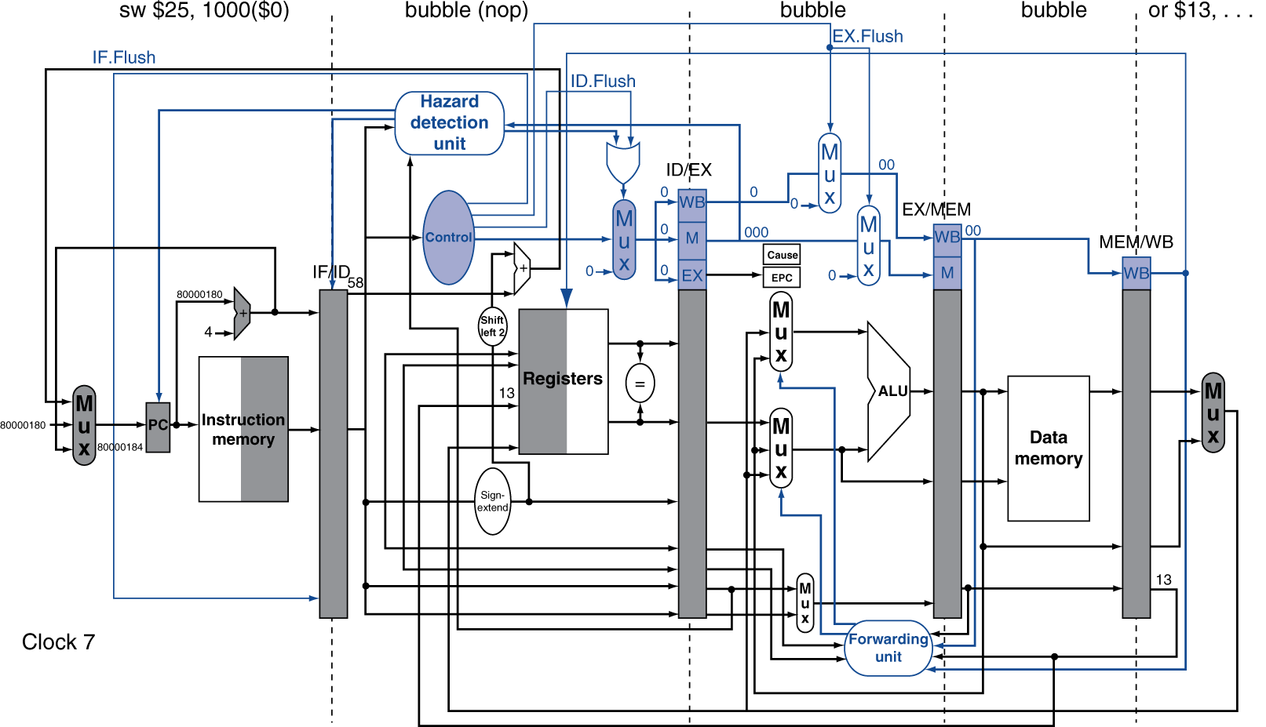
Exception Example
Exception on add in
  40 sub $11, $2, $4
  44 and $12, $2, $5
  48 or $13, $2, $6
  4C add $1, $2, $1
  50 slt $15, $6, $7
  54 lw $16, 50($7)
  …
Handler
  80000180 sw $25, 1000($0)
  80000184 sw $26, 1004($0)
Notes:
Morgan Kaufmann Publishers
Chapter 4 — The Processor

